Slide 1






Application Process Flow
Export
External Source
Flat File / DB
“Inspect” Rules Engine
Template based inputs
Customized Output format
Master Reference
Dashboard
Rule Master
Load
Output File (Any Format)
Output

Slide 2


Application Process Flow
External Source
Flat File / DB
Export
Cordillera
U2K2
Sirius
Fusion
CODA
“Inspect” Rules Engine
Template based inputs
Customized Output format
Master Reference
Dashboard
Rule Master
Load
Output
Output File (Any Format)
External Source
Cordillera
U2K2
Sirius
Fusion
CODA

Slide 3
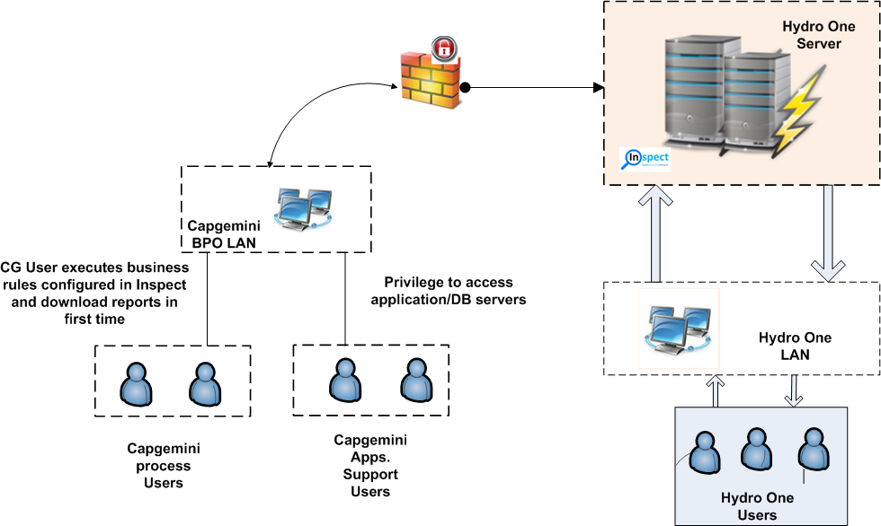
Application Server Configuration
Hardware specifications
Software specifications
Dual core Processer
RAM 16GB
CIFS share Drive 100 GB
HDD space details.
One drive/partition with 50GB
Another drive/partition with 50GB
Windows 2008 R2
SQL Server 2008 R2
SQL Reporting Service & integration service 2008 R2 Component.
Enable IIS
.NET Framework 2.0 & 3.5
MS Office Excel
SMTP enabled
AJAX Tool Kit 1.0
Notes:
Note:
Number of user accessing the application
Number Engagements are going to use this application
Application usage locations
Whether Application will be used in CG intranet
Outside Capgemini Application Access (Internet)
Bandwidth utilization
File Uploads Size and the number of times file gets uploaded
Whether uploaded Files will be stored in Server
IS Archival required.
Note:
Number of user accessing the application
Number Engagements are going to use this application
Application usage locations
Whether Application will be used in CG intranet
Outside Capgemini Application Access (Internet)
Bandwidth utilization
File Uploads Size and the number of times file gets uploaded
Whether uploaded Files will be stored in Server
IS Archival required.

Slide 4












Inspect - Technical Architecture
Presentation Layer
Firewall
Data Layer
Application Layer

Slide 5









Technical Architecture
Application
UI
UX
Business API Layer
1
2
3
4
5
User Mgmt. Services
Service Request Mgmt.
Master Data Services
Data Integration Services
Reporting Services
Infrastructure Services
Message Transformation
Audit / logging
Listeners/ Notifiers
Error handlers
Blockchain Network
Chaincode Services
Blockchain / Transaction Services
Membership Services
Secure container
Consensus
P2P protocol
Registration
Identity Management
Secure registry
Ledger / Storage services
Auditability
Event streaming
Smart Contract

